Slide 1
Case Study- Telecom Churn
BY
Shasank Sharma

Slide 2
# Business Context:
In the telecom industry, customers have the flexibility to choose among various service providers, often switching from one operator to another. Given the highly competitive nature of this market, the telecom sector faces an annual churn rate of 15-25%. Considering the substantial cost (5-10 times more) associated with acquiring new customers compared to retaining existing ones, prioritizing customer retention has become a paramount concern.
# Core Problem:
The primary challenge is to diminish customer churn by identifying and predicting individuals with a high likelihood of leaving the service.
# Objective:
There are two main goals:
1. Develop a predictive model to anticipate whether a high-value customer is likely to churn in the near future.
2. Identify key factors that strongly influence churn and propose effective strategies to manage and mitigate customer attrition. These factors may also shed light on why customers opt to switch to other networks.

Slide 3






Approach Case Study
PCA
To manage the issue of multiple features being strongly related, use PCA (Principal Component Analysis) to select the most important ones.
Identify Model
Data Preparation, EDA
Using information related to customer churn, predict the outcome either through logistic regression or a tree-based model.
Find customers who spend more than most others (70% of customers). Mark those who have stopped using the service, and handle any unusually extreme cases.
Random Forest
Find out which is a better choice between the decision tree and logistic model.
EDA-Data cleaning
Find out where there is no information, and either remove those parts or fill in the missing details.
Strategy to manage churn
Understanding Data
Telecom Churn
Suggest ways to handel customers churn based on what you have observed
Load the information from the file and figure out what details are there in the dataset.

Slide 4
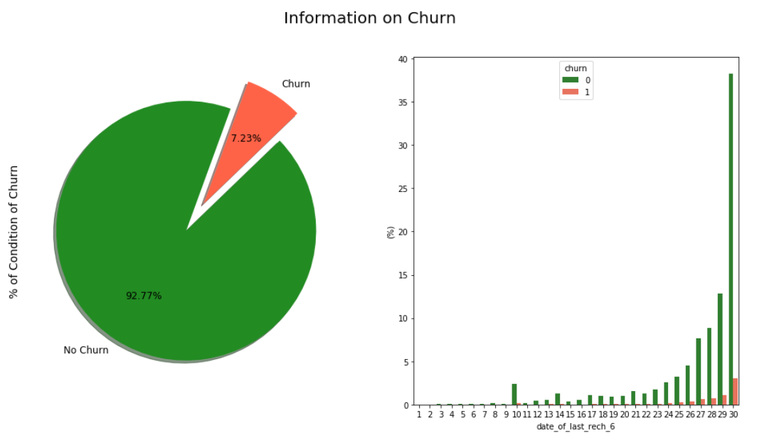
Understanding Data , Preparation & EDA
Data Overview:
Number of unique customers: 99,999
Variables: 226 (12 are objects, 214 are numeric)
Exploratory Data Analysis (EDA):
Missing Values:
40 variables have more than 50% missing values.
Missing values have been replaced with 0 since these variables are crucial for analysis.
Missing values in the date column have been removed.
Filtering High-Value Customers:
Number of High-Value Customers: 29,906
Percentage of High-Value Customers: 30%
Churn Analysis:
2,418 customers out of 29,906 high-value customers are tagged as churns.
The churn cases account for only 8.09% of the total.
The dataset is highly imbalanced, with the majority (91.91%) being non-churners and the minority (8.09%) being churn instances.
After addressing outliers and missing values, non-churns make up 92.77%, and churns make up 7.23%.

Slide 5


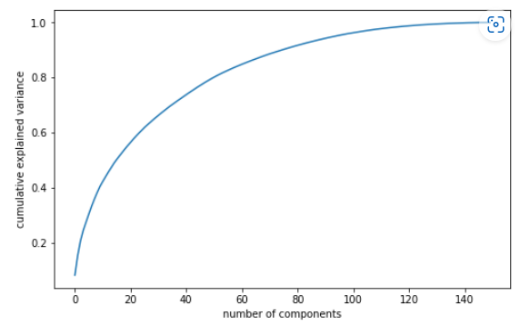
Model Building
Handling Class imbalance:
Before handling imbalance
Because there is a noticeable imbalance, the SMOTE technique is applied to reduce the class imbalance.
After handling imbalance
PCA It's seen that 80 parts explain 90% of the differences in the data. Because we have a lot of data, we're using Incremental PCA as model.
As you can see, the two components are almost unrelated. By cleaning our data from multicollinearity, our models will now be much more dependable.

Slide 6
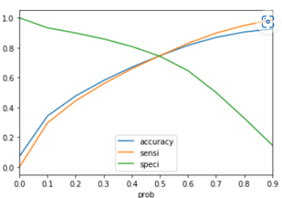
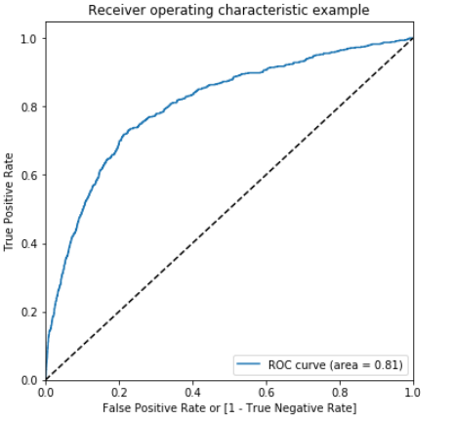

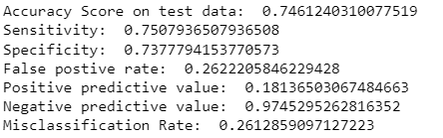
Model Building – Logistic Regression
Optimal probaility threshold:
Logistic Regresion Model:
0.49 is the optimal threshold for logistic regression
We selected the logistic regression model because churn data is for classification. Looking at the ROC curve, the area under it is 0.81, close to one. This indicates that the model is performing well in terms of classification.
Metrics of logistic regression model:
Churn with predicted y with x> 0.49:

Slide 7
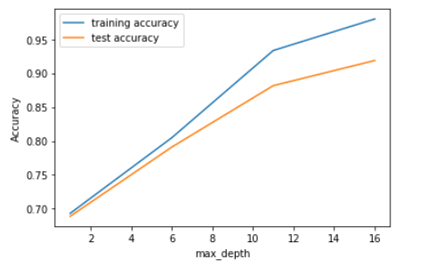
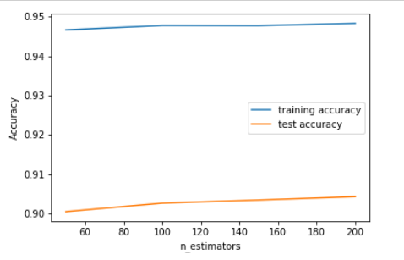
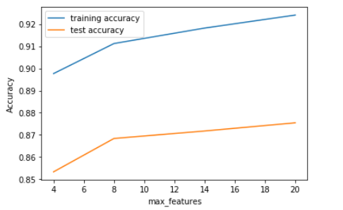
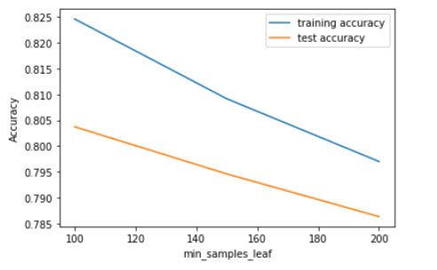
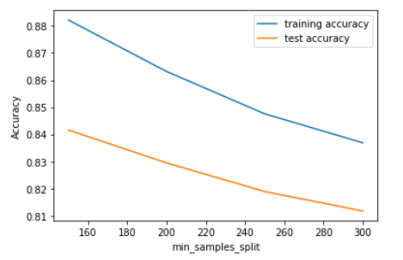
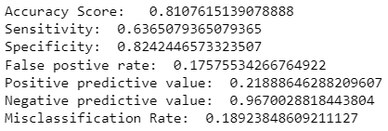
Model Building – Random Forest
Random Forest:
Hyperparameter tuning
Max_depth:
N.estimators:
Max.features:
Min.sample leaf:
Min.sample split:
Metrics of logistic regression model:
Metrics of Random forest model:
In conclusion, after analyzing customer churn, we found that Logistic Regression performed better than the Decision Tree. Logistic Regression has a higher sensitivity and a better specificity score, suggesting it might be effective in predicting potential customer attrition.

Slide 8
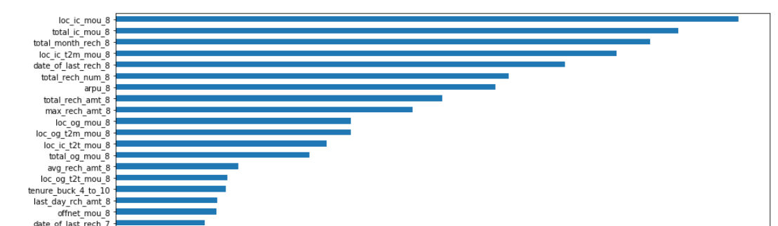
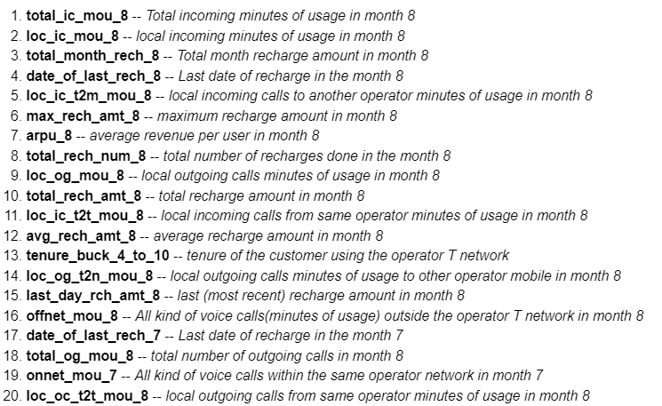
Recommendations & Observations
.Top Variable.
Recommendations:
The key features are mainly linked with month 8, the action phase, according to our Random Forest analysis. Offering discounts and extra service packs during this phase could improve customer retention.

Slide 9
Thank you- Shasank sharma

